Slide 1
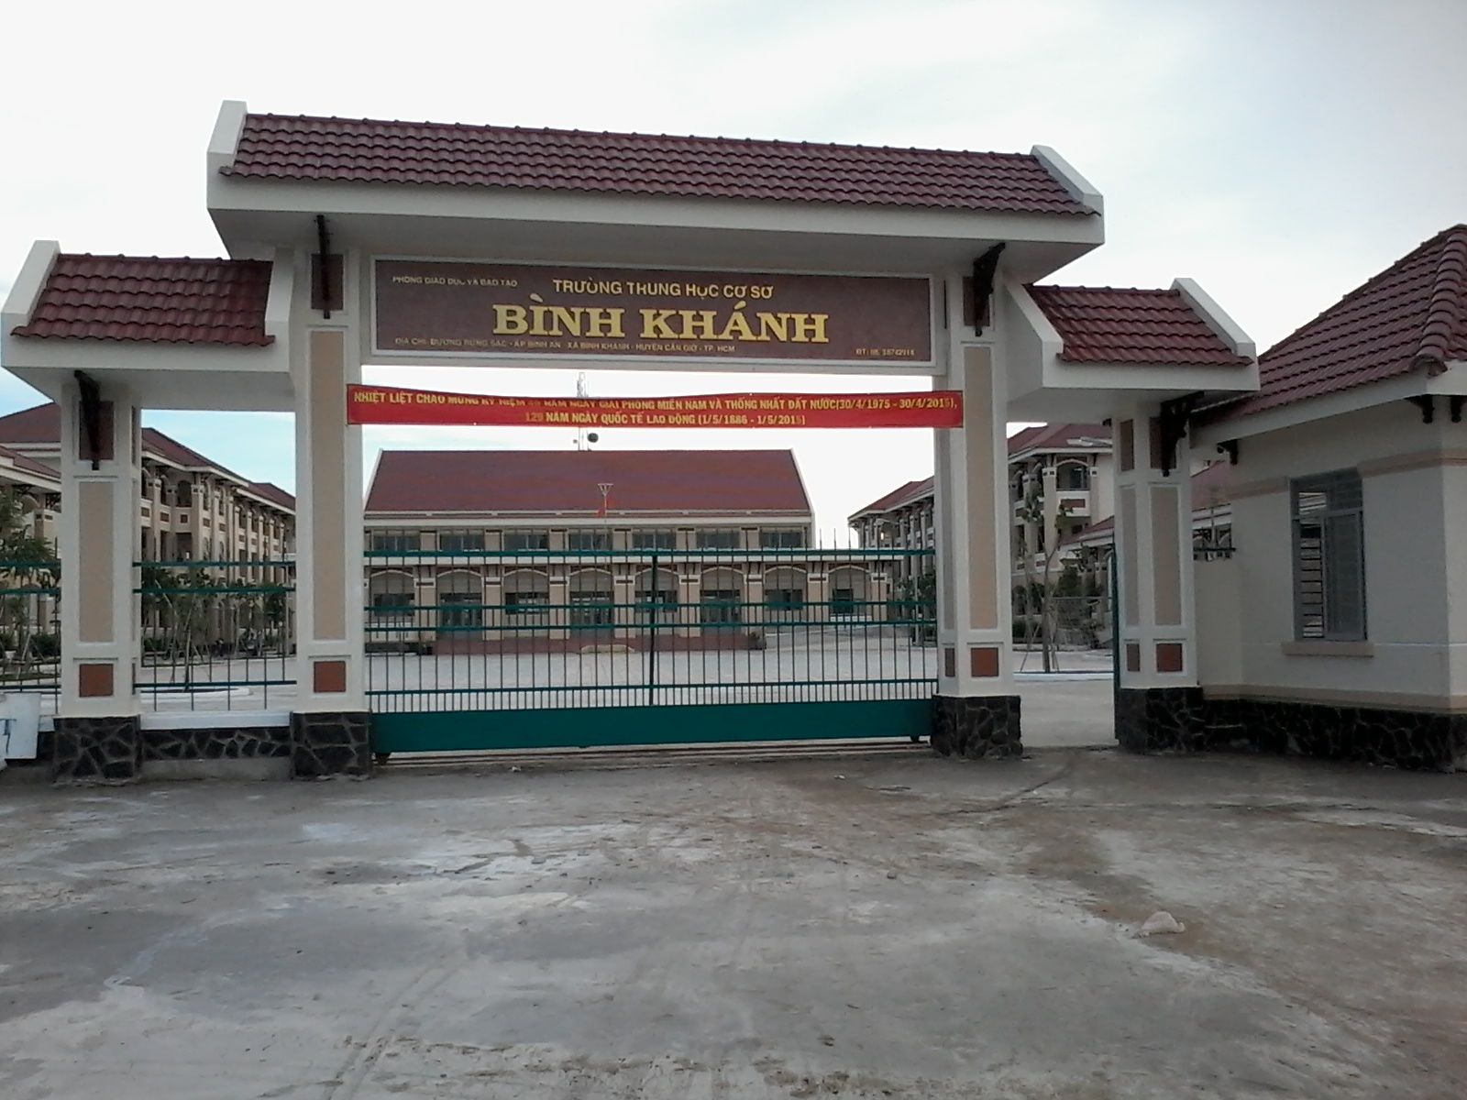



BINH KHANH SECONDARY SCHOOL
FRIENDS PLUS 6

Slide 2

UNIT 2: DAYS
LESSON 3: PRESENT SIMPLE:
AFFIRMATIVE AND NEGATIVE

Slide 3
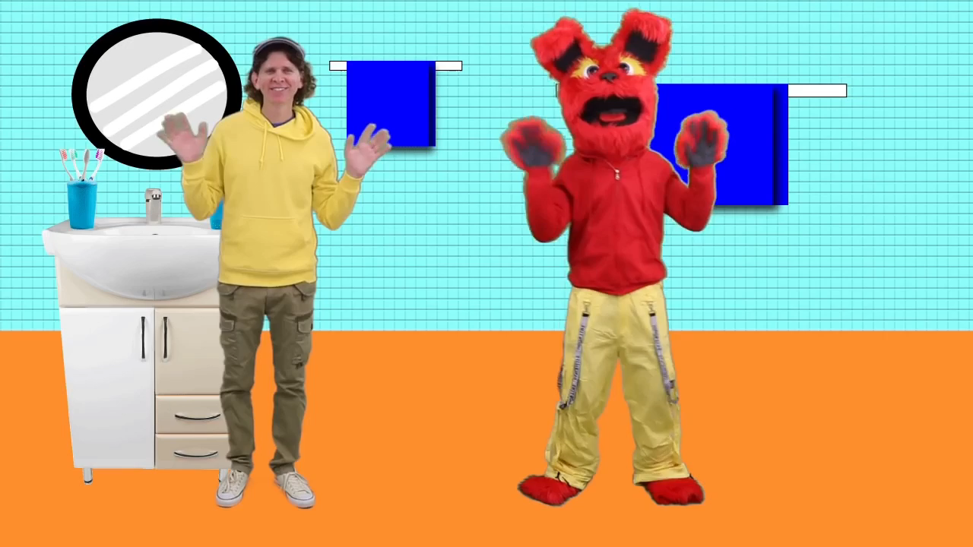

Slide 4
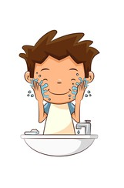
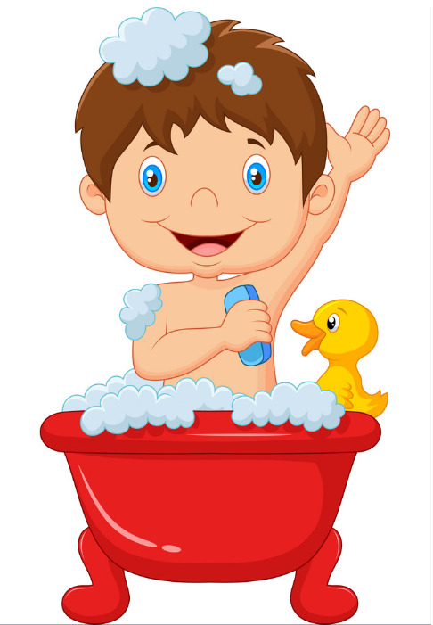
What do you do in the morning?
I wash my face
I take a bath

Slide 5
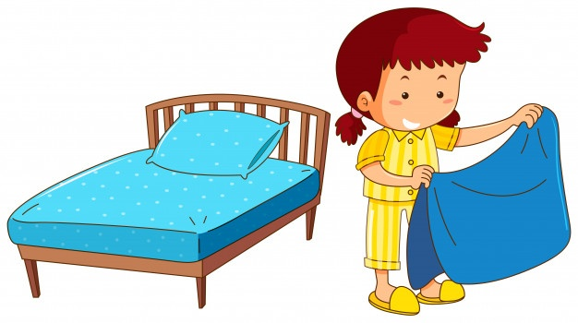

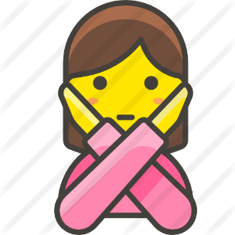
Do you make your bed everyday?
Yes, I do
No, I don’t

Slide 6
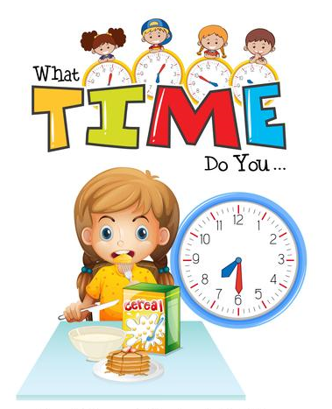
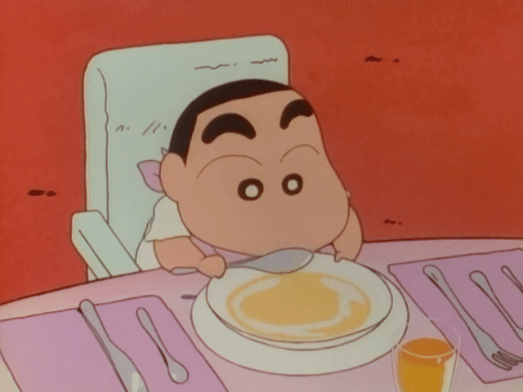
What time do you eat breakfast?
I eat breakfast at 6 in the morning.

Slide 7

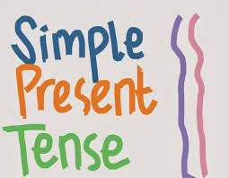
THE SIMPLE PESENT TENSE - THÌ HIỆN TẠI ĐƠN

Slide 8
We use the present simple to talk about:
1
2
3
I'm nineteen years old.
I'm a student.
He lives in London.
The earth goes around the sun.
✓something that is true in the present:

Slide 9
We use the present simple to talk about:
1
2
3
I play football every weekend.
He works in a big bank.
Mary gets up at 6 every morning.
The children don't go to school on Sundays.
✓something that happens regularly in the present:

Slide 10
We use the present simple to talk about:
1
2
3
Every day/ every morning/...
Day after day/...
✓ Use the simple present with:

Slide 11
Eg: They live in Ha Noi. She lives in Ha Noi.
STRUCTURES
Affirmative form:
(+) S + Verb / Verb -s/-es
Negative form:
(-) S + don't / doesn't + Verb-bare
Eg: They don't live in Ha Noi. She doesn't live in Ha Noi.

Slide 12
SPELLING RULES
We use the present simple when we talk about facts and routines. The verbs for he, she and it end differently:
We add -s to most verbs:
+ Work → works
+ Live → lives
We remove -y and add -ies when a verb ends with a consonant + y.
+ Try → Tries
+ Fly → flies
*** With a vowel + y:
+ Play → plays
+ Stay → stays
We add -es when a verb ends with: -o, -ch, -s, -sh, -x or -z.
+ Watch → watches
+ Wash → washes
+ Mix → mixes
+ Go → goes

Slide 13
EXERCISE 1: Compare the sentences. Then match a-d with spelling rules 1-4
The sentences | Spelling rules
I study a lot. / Her older daughter studies hard | 1. We add -s to most verbs: play plays.
b. We have breakfast at 7.30 a.m. / He has breakfast at 5.30 a.m. | 2. We add -es when a verb ends with -o, -ch, -s, -sh, -x or -z.
c. My brother and I go to school. / He goes to work. | 3. We remove -y and add -ies when a verb ends with a consonant + y.
d. I get up at 7 a.m. / Noel gets up at 4.45 a.m. | 4. We use has instead of have.
1-d; 2-c; 3-a; 4-b

Slide 14
EXERCISE 2: Choose the correct verbs
1. You go / goes to bed at 9.30 p.m.
2. My parents relaxes / relax in the evening.
3. My teacher speaks / speak four languages.
4. Our English class finish / finishes at 3 p.m.
5. I has / have lunch at home.
6. My sister studies / study at the weekend.

Slide 15
EXERCISE 3: Pronunciation-third person -s
/s/: -p, -k, -t, -f | /iz/: /s/, /z/, /ʃ/, /tʃ/, /ʒ/, /dʒ/. | /z/: /b/, /d/, /g/, /v/, /ð/, /m/, /n/, /ŋ, /l/, /r/,...
Eg: Stops /stop/ Laughs /læfs/ | Eg: Watches / wɑːtʃiz/ Washes /wɑːʃiz/ | Eg: Plays /pleɪz/ Bags /bægz/
1 a. relaxes b. finishes d. boxes
c. studies
c. watches
2 a. goes b. does d. toes
3 b. watches c. beaches d. matches
a. aches
4 a. washes b. wishes d. witches
c. makes
5 a. takes b. makes c. aches
d. watches

Slide 16
EXERCISE 4: Complete the examples from the text on page 26.
don't help
1. The younger children ………………
doesn't watch
2. Sue ……………….....TV a lot.
don't
go
3. The Radfords ………...usually ….....to restaurants.

Slide 17
EXERCISE 5: Look at the information in the table. Write affirmative and negative about people.
 | Tom | Vicky | Mina
Wash the dishes | ✓ | X | ✓
Wash the car | ✓ | X | ✓
Sit on the sofa a lot | ✓ | ✓ | X
Make breakfast | X | X | ✓
Watch TV a lot | X | ✓ | X
→ Tom and Vicky sit on the sofa a lot.
→ Mina doesn't sit on the sofa a lot.
→ Tom and Vicky don't make breakfast.
→ Mina makes breakfast.
→ Tom and Mina don't watch TV a lot.
→ Vicky watches TV a lot.

Slide 18

EXERCISE 6: Discussion
What does each person in your family do at home?

Slide 19


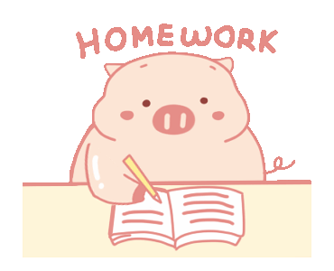
- Learn by heart all the new words
- Prepare for next lesson – Speaking

